Slide 1
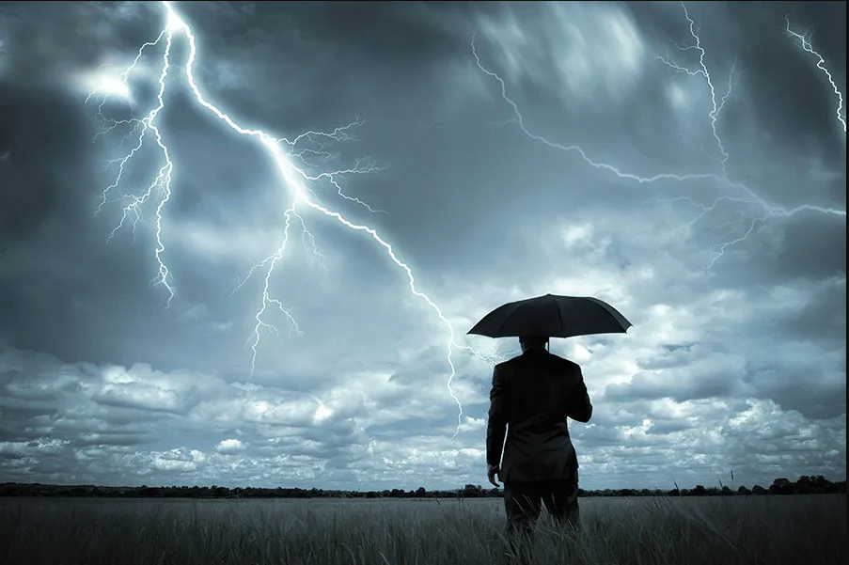
Into the storm

Slide 2
The Truth about storms
No body is exempted
It will always come
It reveals something in us

Slide 3
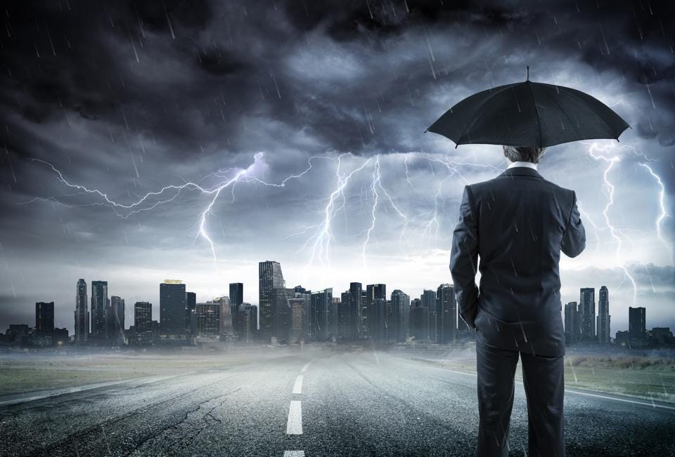
3 Types of Storm that we Could Experience

Slide 4

1. The storm of Testing
James 1:2-3 NIV Consider it pure joy, my brothers and sisters, whenever you face trials of many kinds, because you know that the testing of your faith produces perseverance.

Slide 5
2. Storm of Disobedient
Jonah 1:4-5 NIV Then the Lord sent a great wind on the sea, and such a violent storm arose that the ship threatened to break up. All the sailors were afraid and each cried out to his own god. And they threw the cargo into the sea to lighten the ship. But Jonah had gone below deck, where he lay down and fell into a deep sleep.

Slide 6
3. Storm of Obedient
Mark 4:35 NIV
That day when evening came, he said to his disciples, “Let us go over to the other side.”

Slide 7
3. Storm of Obedient
Matthew 14:22 NIV
Immediately Jesus made the disciples get into the boat and go on ahead of him to the other side, while he dismissed the crowd.

Slide 8
The storm reveals:
reveal the nature of faith
reveal the strength of commitment
reveal the level of maturity
reveal the health of attitude
reveal the measure of teachability

Slide 10
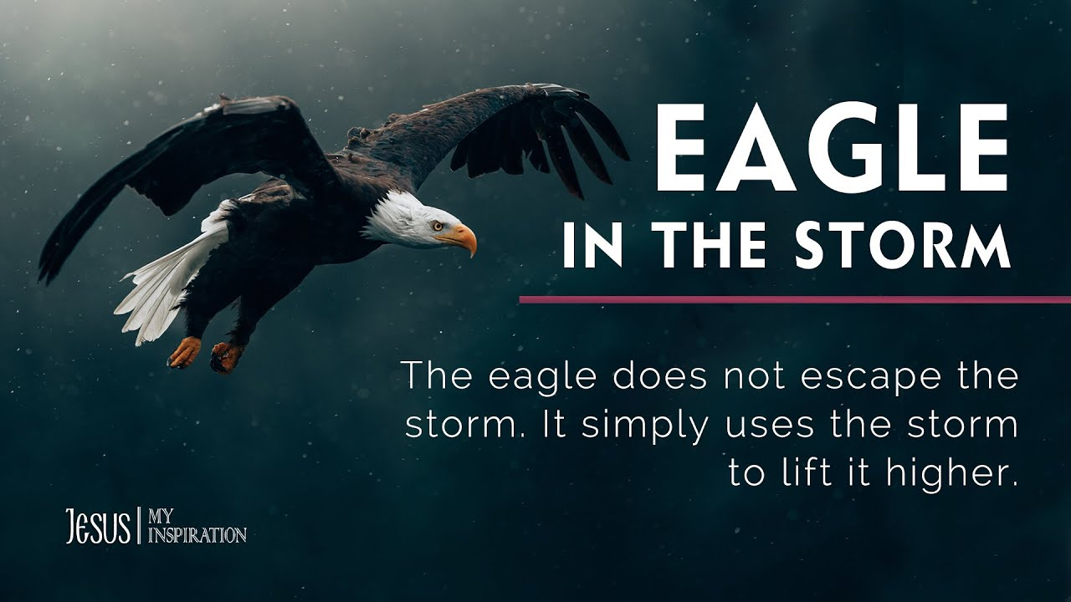
Facing The Storm

Slide 11
Facing the storm like an eagle
Understand the storm
is the only bird that looks for storm
the eagle gladly welcome the storms
the eagle uses the storm to increase their height
the eagle flies towards the storm

Slide 12
Facing the storm like an eagle
the eagle uses the storm to cleans his feather
the eagle uses the storm to test its pinions and bones
the eagle uses the storm to renew his strength
the eagle will leave the storm after using the storm

Slide 13
The storm reveals:
reveal the nature of faith
reveal the strength of commitment
reveal the level of maturity
reveal the health of attitude
reveal the measure of teachability

